Slide 1
Graduate Business Research
Expectations, skills and resources
Semester 2, 2017

Slide 2
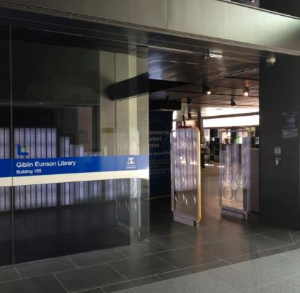
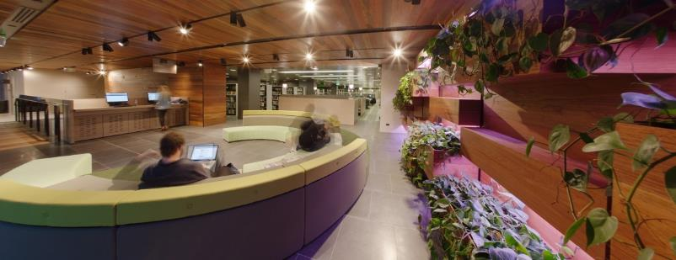
Introduction
Giblin Eunson Library
Building 105, 111 Barry Street
Collection
Business & Economics
Education
Connect with us
library.unimelb.edu.au
facebook.com/unilibrary
twitter.com/unilibrary

Slide 3
Business and economics librarians
Aimee Clague
Bernard Lyons
Kristijan Causovski
Trent Hennessey
Ben Gilmour
Biomedical research & commercialisation
Business law
Banking & finance
Accounting
Economics
Marketing
HR & Management
Entrepreneurship
Business case analysis

Slide 4
Library support throughout your graduate degree?

Slide 5
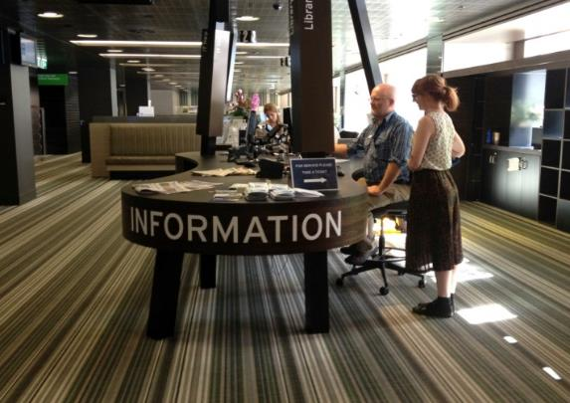
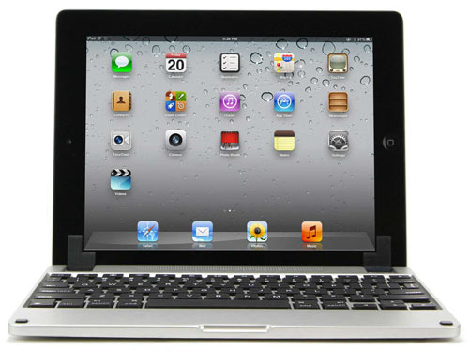
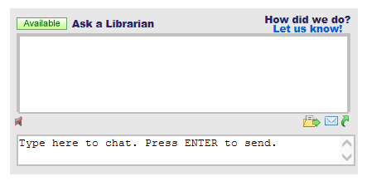
Support from the library
Visit the Giblin Eunson Library information desk
Chat with us @ library.unimelb.edu.au

Slide 6
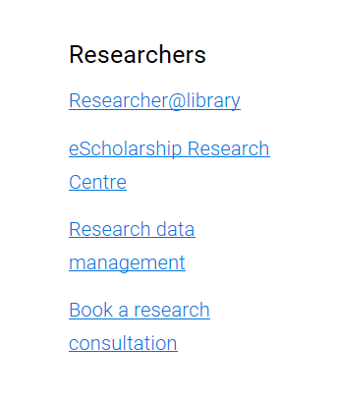
Support from the library
As graduate students, you can book individual or group research consultations with us to help you find information and develop your research skills.
Book online through the library homepage.
http://library.unimelb.edu.au/research/research-consultations

Slide 7
Setting you up for your graduate studies
Three key aims for this session:
Highlight the library services you can access.
Increase your knowledge of the range of available library resources.
Familiarise you with the latest developments in advanced searching.
ACTIVITY SHEET: Before we begin, how would you rate your knowledge of library resources and research skills?

Slide 8
Setting you up for your graduate studies
Part A: Frequently asked questions
Focus: Library services and resources
Part B: Four common research problems
Focus: Advanced research skills

Slide 9
PART A: Frequently asked questions
Library services and resources

Slide 10
Top 10 library questions
1. When are you open?
Opening hours for all our libraries and after-hours study spaces can be found from the library homepage: http://library.unimelb.edu.au/hours
2. Does the library have textbooks?
Yes. They are in our ‘High Use’ section and are available for 2-hour or overnight loan. Find your textbooks in the library catalogue by searching via ‘Subject Code/Name’. http://cat.lib.unimelb.edu.au/
3. How do I book a library computer or project room?
Our online Bookit! service is available as a Quick Link from the library homepage, or a direct link is: https://bookit.unimelb.edu.au/cire/login.aspx
ACTIVITY SHEET: Note down answers for questions of interest.

Slide 11
Top 10 library questions
4. Do you have printing and scanning facilities?
Yes. Scanning is free. Wireless printing uses your Student Card. You can add money to your account online or at Autoloader machines in libraries. More information: https://unicard.unimelb.edu.au/
5. Can you help with tech problems?
Student IT can help with wireless connections and tech issues. They are located next to the Information Desk on the ground floor of the library. More information: http://studentit.unimelb.edu.au/
6. How many books can I borrow?
100.
ACTIVITY SHEET: Note down answers for questions of interest.

Slide 12
Top 10 library questions
7. Is it free to place a hold on an item?
Yes. If an item is currently on loan, you can place a hold on the item to reserve it.
8. Do I have to return items to the same library?
The only items you need to return to the same library are High Use items (so we can return them for reuse as quickly as possible).
9. Can I renew my items online?
Yes. Renew items online through your ‘Borrowing Record’ which is under ‘Quick Links’ on the library homepage (http://www.library.unimelb.edu.au)
10. How can I check my library fines?
Through your ‘Borrowing Record’ (see question 9).
ACTIVITY SHEET: Note down answers for questions of interest.

Slide 13
PART B: Common research problems
Advanced research skills

Slide 14
Common problems facing graduate business students
1. Finding company and industry information.
2. Understanding the latest industry thought leadership and news.
3. Navigating the academic literature.
4. Streamlining the referencing process.

Slide 15
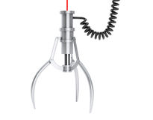
We’ll focus on
building your skills
at each stage of
the research cycle.
1. Plan
3. Search
4. Evaluate results
5. Document
2. Identify sources
The research cycle

Slide 16
PROBLEM 1:
Finding company and industry information

Slide 17
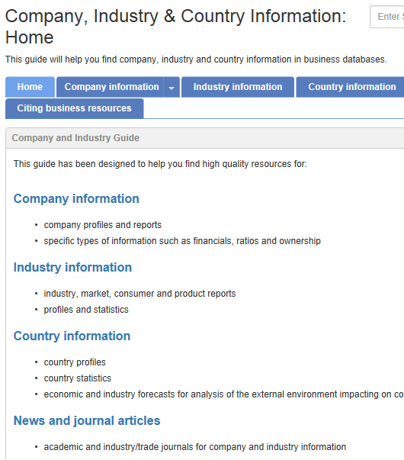
Specialised databases can be found in the library’s ‘Company, Industry, & Country Information’ guide. There are databases to support each level of analysis.
Levels of analysis
Macro-environment
Consumer market
Company
Product/ brand
Industry

Slide 18
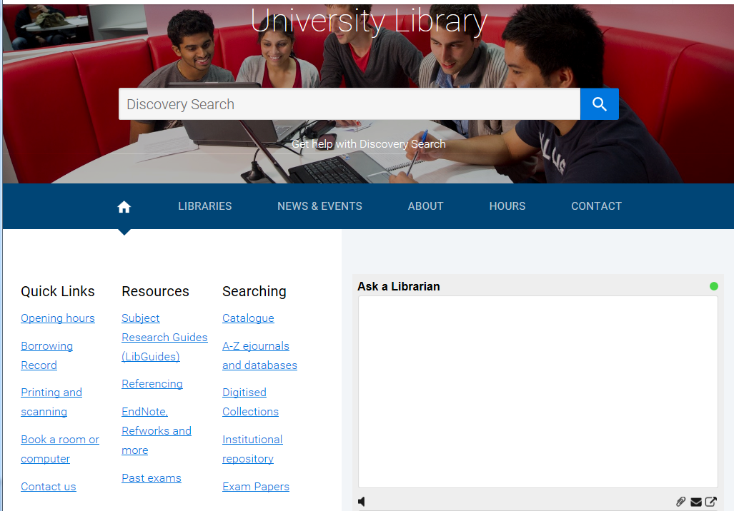
A ‘subject research guide’ showcases the library’s specialised resources for different areas of study.
You will find the guides on our website
library.unimelb.edu.au
Notes:
Update slide to include Advanced Search

Slide 19
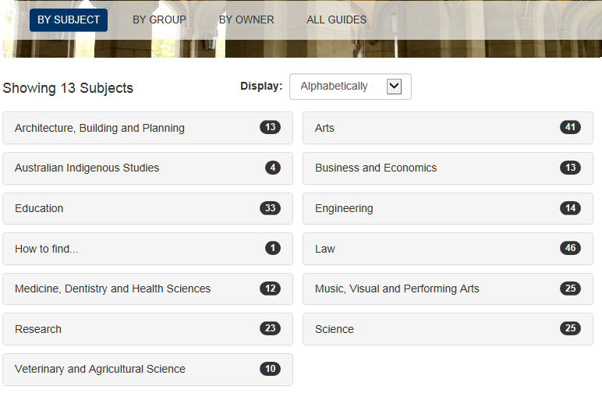
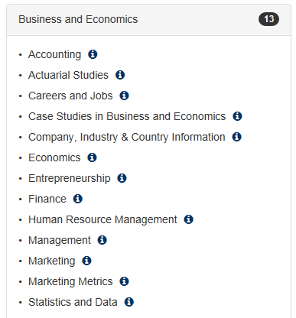
The range of business and economics guides will support you through your studies. Today we will focus on the ‘Company, Industry, & Country Information’ guide.

Slide 20
The availability of company information
The information available on an organisation varies dramatically.
More information available
Less information available
Public companies Multinationals
Start-ups Small/medium-sized Not-for-profits
private companies
ACTIVITY SHEET: Let’s review the types of companies based on information availability.

Slide 21
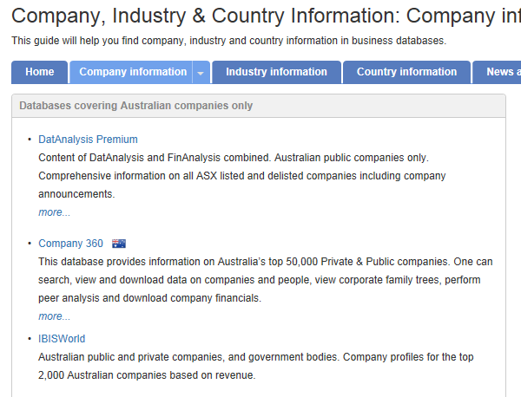
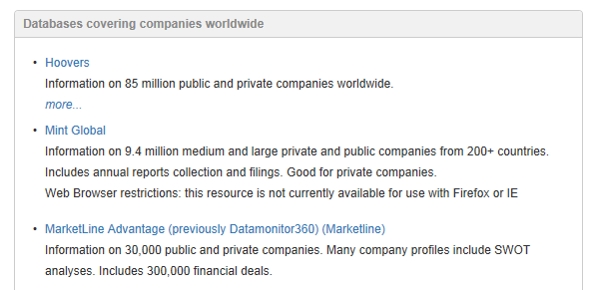
Company reports
1. Move to the ‘Company’ section of the guide.
2. Is your company Australian? This will impact on which company database you search in.
Advantages of company reports compared to annual reports?
Multi-year financials
Objective analysis
Forecasts

Slide 22
Our three leading databases for Australian company information:
Company reports on the top 50,000 public and private Australian companies.
Company reports on the top 2000 Australian and New Zealand public and private companies.
Company reports on Australian public companies.

Slide 23
Industry reports – Australia and international markets
Our collection of industry databases provides access to a range of premium reports and proprietary data produced by analysts.
These databases are owned by competing information services companies – they each have strengths and specialisations to differentiate themselves.
TIP: We recommend searching across several of these databases.

Slide 24
Scenario
A client has designed an app for customer bookings and payments. They believe a major customer segment could be hair salons. They want to understand:
In Australia, is the hairdressing industry forecast to grow or decline in the next five years?
Who are the largest companies to target in this industry?

Slide 25
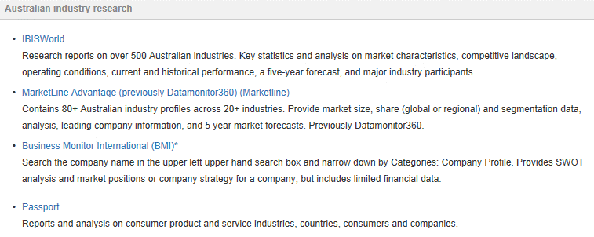
Australian industry reports
IBISWorld provides the most comprehensive range of reports (500+) on Australian industries.

Slide 26
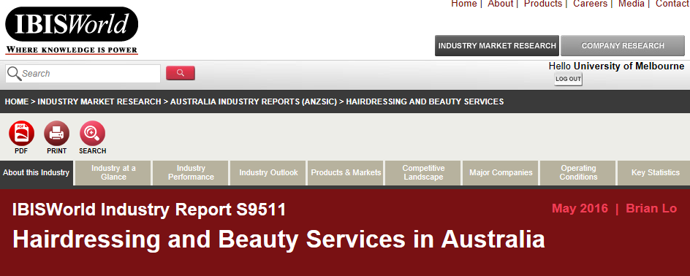
Example: IBISWorld industry reports
Download the full PDF reports so you can cite the document (generally about 20-30 pages).
Click through these tabs to find data on industry growth and forecasts.
Good source of recent data. Most reports updated quarterly/bi-annually.

Slide 27
PROBLEM 2:
Understanding the latest industry thought leadership and research news

Slide 28
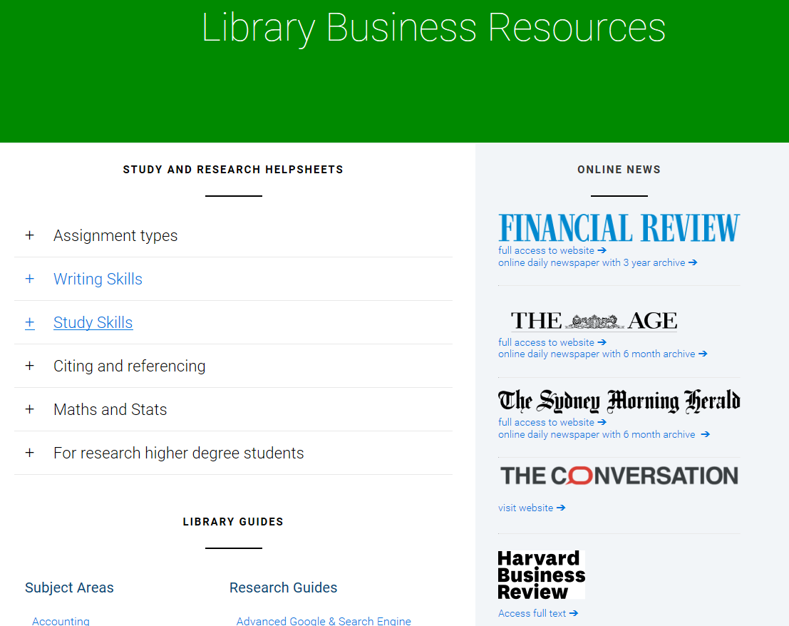
Accessing online news
Avoid paywalls by accessing our newspaper subscriptions online.
library.unimelb.edu.au/business-resources
library.unimelb.edu.au/business-resources

Slide 29
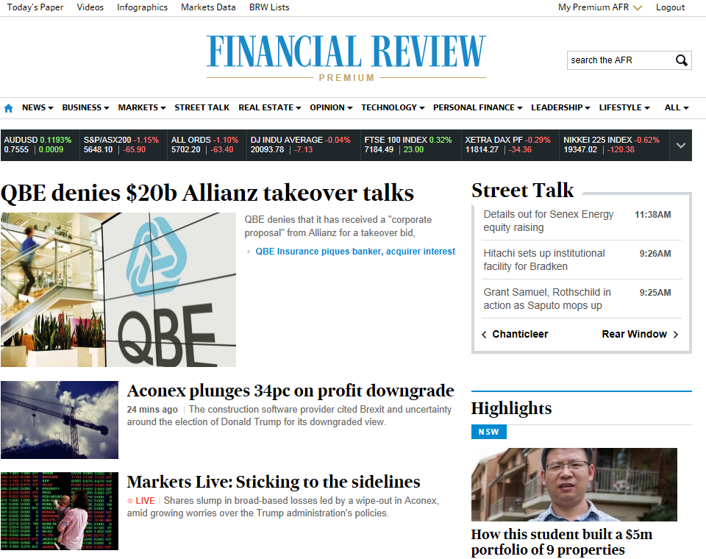
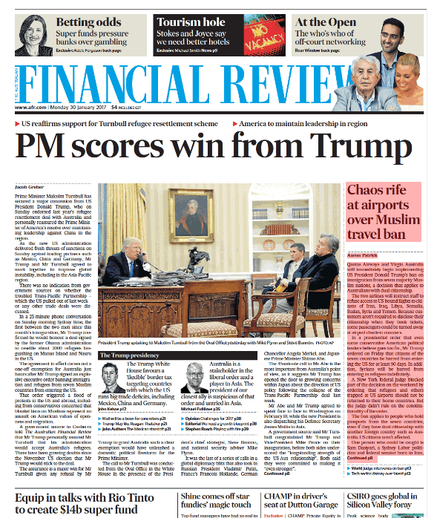
How do you prefer to read?
Reading from the website
Browse the digital replica of the print edition

Slide 30
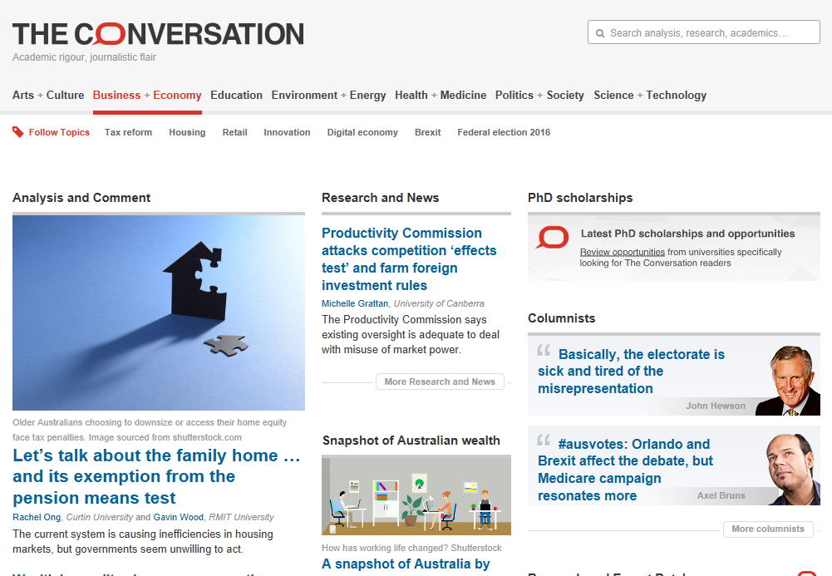
Academic perspectives on the news
Independent and authoritative news written by academic researchers.
Sign up to their excellent daily e-newsletter.

Slide 31
Industry insights
The world’s leading consulting firms each maintain a library of their research publications.
Click on the companies to explore and sign-up to their newsletters and social media links.

Slide 32
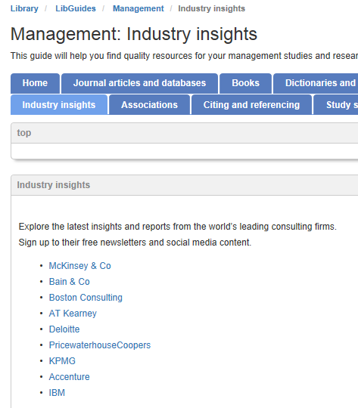
Industry insights
Links to industry insights are also provided in our Management subject guide.

Slide 33
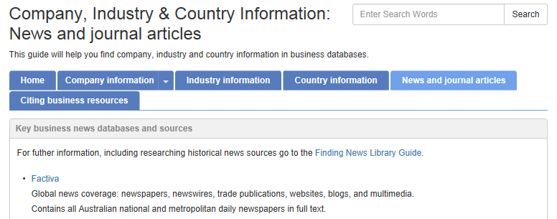
Meta-searching business news
Factiva is a continuously updated global news database of 35,000+ newspapers, magazines, trade journals, newswires from Dow Jones and Reuters, blogs, and websites from more than 200 countries.
Factiva contains full-text copies of newspaper articles.
The library has access for 10 concurrent users at a time.

Slide 34
PROBLEM 3:
Navigating the academic literature

Slide 35
Identifying relevant resource types
Commonly used resources in business and economics
Company reports
Industry profiles
Government reports
Books or eBooks
Case studies
Newspaper articles
Statistics or financial information
Trade journal articles
Peer-reviewed journal articles

Slide 36
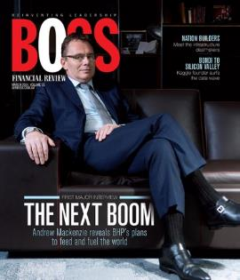
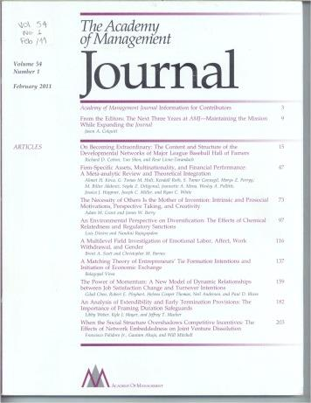
Understanding types of journals
Peer-reviewed journals
Also known as scholarly, academic, or refereed journals
Written by academics
Always include a reference list
Journal content is reviewed by experts before publication
Examples: Journal of Organizational Behavior, Academy of Management Review
Trade journals
Also known as practitioner journals or magazines
May be written by journalists or practitioners
May not have a reference list
Are not peer-reviewed
Examples: HRMonthly, Boss Magazine
USEFUL FOR: Theory, concepts, models, research evidence (statistics and findings).
USEFUL FOR: Company examples, best practice, case studies, industry trends.

Slide 37
Understanding types of journals
Peer-reviewed journals
Trade
journals
THIRD CATEGORY
The following three journals highlight the managerial implications of the latest academic research in business and economics:
Harvard Business Review Sloan Management Review California Management Review

Slide 38
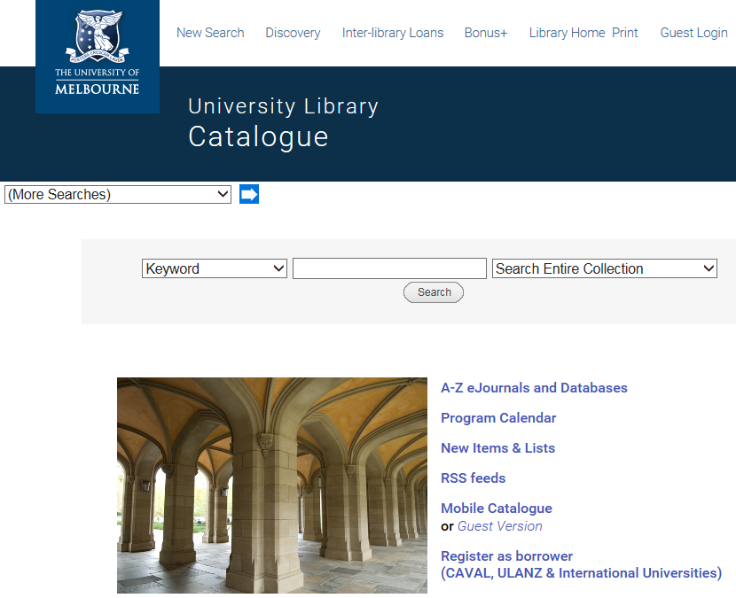
The library catalogue
3.5+ million items in the collection.
Search for specific types of sources (e.g. eBooks).
Use your subject codes to search for your textbooks and recommended readings.

Slide 39
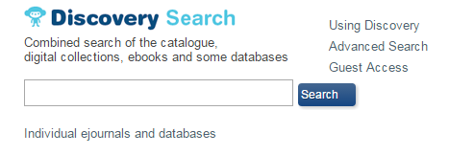
Discovery search
Basic Discovery search
Good for broad, general searches.
Not specific to business and economics.
You will need to filter your search to narrow down to relevant results.
Advanced Discovery search

Slide 40
Academic journal databases
Three key messages for you:
There are specialised business and economics academic databases.
Our subject research guides show you the most relevant databases for each sub-discipline.
Try your search strategies in different databases.
For example, Business Source Complete, Proquest, and Google Scholar.
TIP: Use your advanced search techniques in these databases.

Slide 41
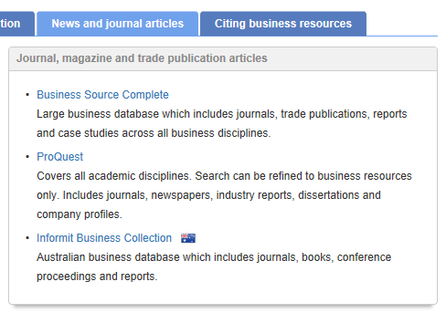
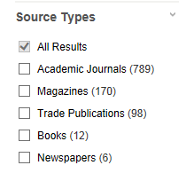
FOCUS: finding trade and academic journal articles
TIP: Databases allow you to filter your search results by source type to find the academic or trade literature you need.
TIP: The top two specialised business databases for academic journal article and trade publication searching.

Slide 42
When searching in databases…
Undertake multiple searches to test different search terms.
Scan the first 20 results → Evaluate what works and what doesn’t → Record your searches in your diary → Search again
TIP: Add multiple articles of interest to a folder to speed up your reading/saving/emailing/printing process.

Slide 43
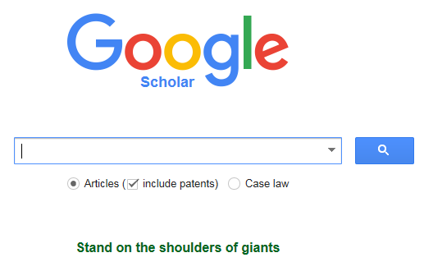
Google Scholar academic database
Began as a Google project in November 2004.
Free web search engine containing most peer-reviewed online journals, scholarly books, and trade publication journals.
Great for discovering sources and general, broad searches.

Slide 44
Link your unimelb account to Google scholar
Five steps to link your unimelb library account to Google scholar:
Go to http://scholar.google.com
Click ‘Settings’ in the top-right corner.
Click ‘Library Links’ on the left-hand side.
Search for “University of Melbourne”.
Click ‘Save’.
You can now click on ‘SourceIt@Melbourne’ links to access the full text articles you are interested in from Google scholar through library resources.

Slide 45
Planning your search strategy
Start with your assignment topic/question. Identify:
Key words: individual concepts to search for (e.g. compensation, budget).
Key terms: words that form a term (e.g. “stakeholder theory”, “organisational behaviour”)
Alternative words: very important to consider given the
Key words/terms
Key word/term (from assignment topic) | Key word/term 2 | Key word/term 3 | Key word/term 4
Remuneration | Salary | Wage | Income
Recruitment | Recruiting | Interviews | “Recruitment and selection”
TIP: A list or table might help you to manage this process and ensure you have a systematic approach to your research.

Slide 46
Advanced search techniques to use in databases
Variations of a word?
Use truncation (*)
manag* searches for managing, management, manager
US vs UK spelling?
Use wildcard (?) searches for variations of a character.
organi?ational searches for organisational and organizational
Generic key terms?
Use quotations marks (“ ”) for phrase searching.
“accounting standards” keeps these key words together as a term
Synonyms or related terms?
Use AND, OR, NOT to refine the search phrase.
(fiscal OR monetary) searches for these alternative key terms

Slide 47
Practise using advanced search techniques
A search for literature on the topic of organisational strategy.
Possible search terms: “organi?ational strategy”
Advanced search techniques
1. Variations of a word = truncation (*)
2. US vs UK spelling = wildcard (?) searches for variations of a character
3. Generic key terms = quotations marks (“ ”) work for phrase searching
4. Synonyms or related terms = AND, OR, NOT with terms in brackets
ACTIVITY SHEET: Let’s workshop these three questions.

Slide 48
Practise using advanced search techniques
2. A literature review of the marketing strategies of luxury brands in China.
Possible search terms: “marketing strateg*” AND (luxury OR premium) brand* AND (China OR Chinese)
Advanced search techniques
Variations of a word = truncation (*)
US vs UK spelling = wildcard (?) searches for variations of a character
Generic key terms = quotations marks (“ ”) work for phrase searching
Synonyms or related terms = AND, OR, NOT with terms in brackets
ACTIVITY SHEET: Let’s workshop these three questions.

Slide 49
Practise using advanced search techniques
3. After the global financial crisis, what regulations have been placed on financial institutions and markets?
Possible search terms: (“global financial crisis” OR GFC) AND (bank* OR “financial institution*” OR “financial market*”) AND (regulat* OR restrict*)
Advanced search techniques
Variations of a word = truncation (*)
US vs UK spelling = wildcard (?) searches for variations of a character
Generic key terms = quotations marks (“ ”) work for phrase searching
Synonyms or related terms = AND, OR, NOT with terms in brackets
ACTIVITY SHEET: Let’s workshop these three questions.

Slide 50
PROBLEM 4:
Streamlining the referencing process

Slide 51
Advanced citation techniques
Smith (2016) said it is not good.
It was not good (Smith, 2016).
These basic ways of citing the research you find can be developed further with more critical and analytical approaches.
Let’s overview three advanced citation techniques.

Slide 52
Advanced citation techniques
Add relevant contextual information.
About the researcher
Critical economics theorist Emily Jones (2016)…
Methodology
Based on a longitudinal survey of Chinese households, Lu (2014) found …

Slide 53
Advanced citation techniques
2. Identify consensus/debate in the literature.
Consensus
Consumer studies from Australia (Davies, 2016), China (Xu & Chan, 2014), and Canada (Deshwar, 2013) all found consumer confidence declined as employment volatility rose between 2009-2012.
Debate
There are conflicting findings in the literature about the effects of open plan offices on employee productivity, with….

Slide 54
Advanced citation techniques
3. Diagnose the current state of knowledge.
The importance of independent auditing of company financial statements is well established in the literature (Heast, 1963; Van Jenh, 1985; Keller, 2001).
There is a lack of research examining…
There is emerging evidence on…

Slide 55
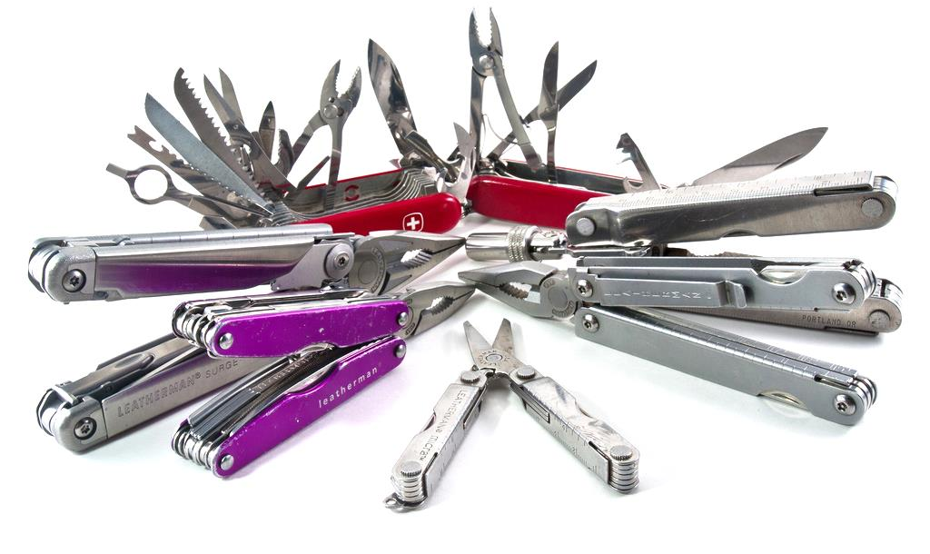
Referencing just became easier
There’s a range of quick and easy-to-use tools to perfect your citations and references.
Image: https://flic.kr/p/9aXqae

Slide 56
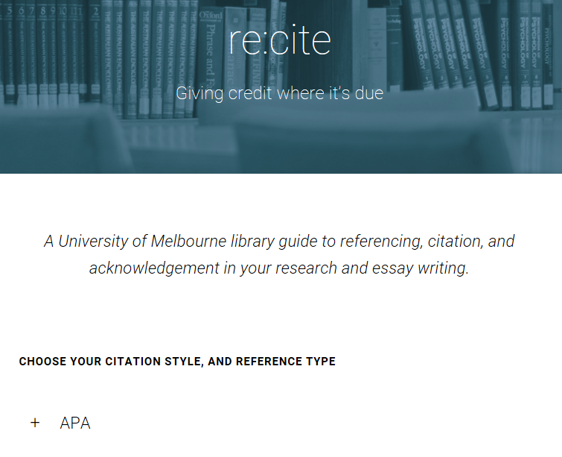
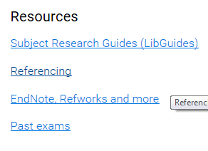
Citing and referencing tools
Q: Need help formatting your citations and reference list? A: Re:Cite is a library tool to guide you through using common referencing styles such as APA.

Slide 57
Yes, you can, library cat.
Examples are in Re:Cite.
Can I cite industry sources?

Slide 58
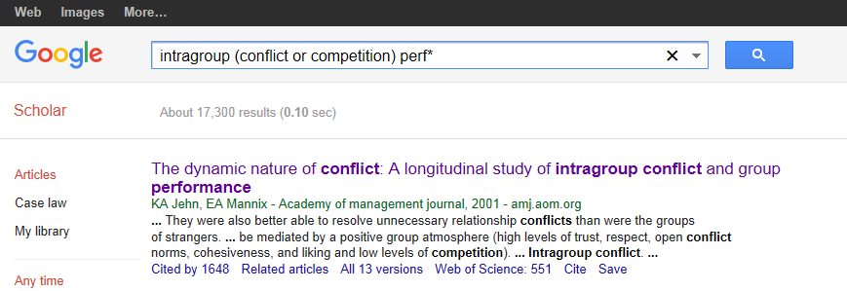
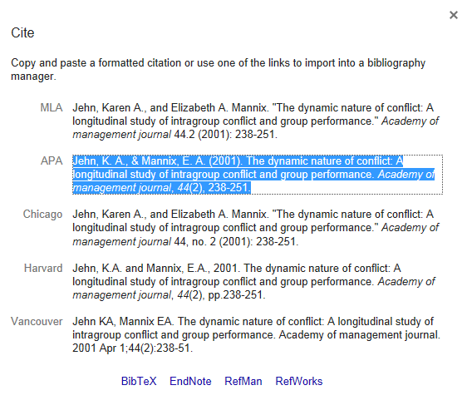
Citing and referencing tools
Research databases format references for you (click on ‘cite’ or ‘export’ links).
TIP: Database-generated references are improving in quality, but do check to confirm accuracy.

Slide 59
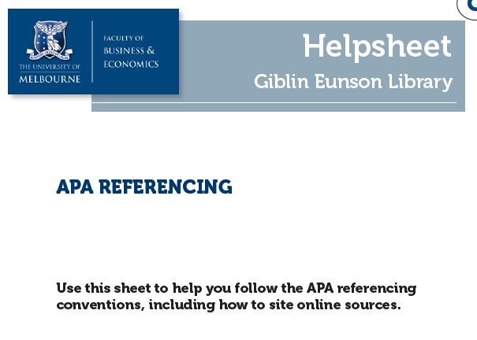
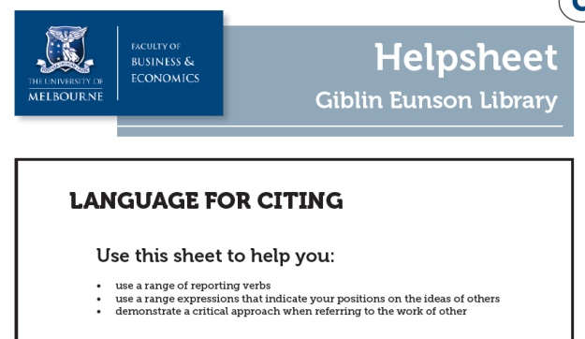
Citing and referencing helpsheets
For more detailed guidance,
see the library’s referencing
helpsheets on our website.

Slide 60
Reference management software
Software that stores, organises, and generates citations and bibliographies for you.
Particularly useful for students undertaking a mini-thesis or large research project with many references.
You will need to choose which software to use. The three big providers are:

Slide 61
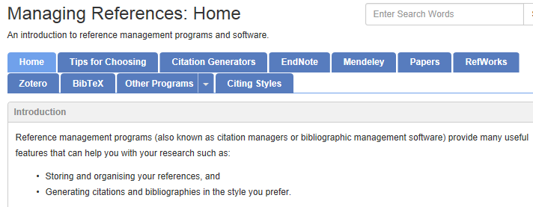
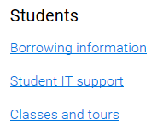
Reference management software
More information about the software?
See our guide on Managing References.
Attend a class on using the software?
Enrol in a class from our website.

Slide 62
Summing up…

Slide 63
Five key points
The library’s subject research guides for business and economics will connect you to the best resources available.
Transition from basic to advanced search techniques to find the most relevant, high quality academic literature.
Explore the different business databases to find company, industry, and country information.
Perfect your citing and referencing with our easy-to-use tools.
We are here to help you.

