Slide 2
Session Outline
The writing process
Academic & business writing at MBS
Research
Writing & editing task

Slide 3
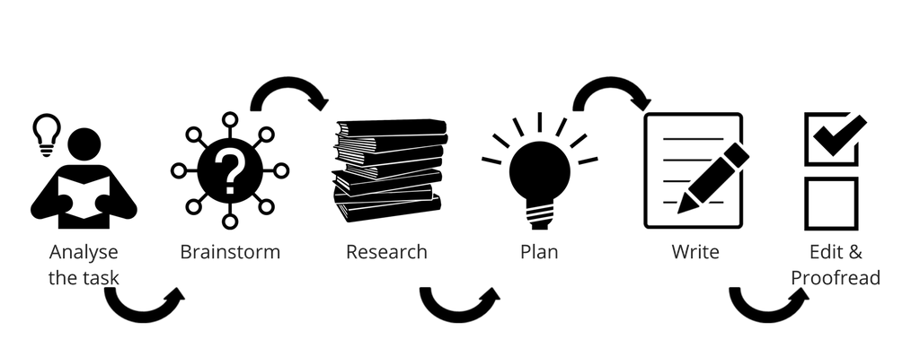
The writing process

Slide 4
Academic & Business writing
What texts might you write in a business context / academic context?
What sources might you need to refer to?
How does academic style and professional style differ?

Slide 5
STAGE 1: Analyse the task/genre
GENRE [WHAT?] | AIM [WHY?] | AUDIENCE [WHO?]
Structure | Argument / contention Content & Structure
What are you writing?
Essay, report, business plan…
What are the features/rules of that genre?
Why are you writing this text?
What do you want your reader to do/know/believe?
Who will read it?
What do they need to know?
What’s their level of knowledge?
How will they read it?
Content + Structure + Style

Slide 6
Adapted from: http://learnonline.canberra.edu.au/mod/book/view.php?id=180631&chapterid=332
Academic essay vs professional report
 | A | B
Aim | present facts/information, and explain them as clearly as possible | discuss perspectives on an issue, usually to construct an argument for a particular point of view
Audience | written for the person or organisation that requested them | written for a lecturer and other knowledgeable people in the field
How they’re read | will be scanned | will be read carefully from beginning to end
Paragraphs | use short, concise paragraphs and dot-points where applicable | link ideas together into a cohesive series of paragraphs, rather than breaking ideas down into easy-to-access pieces
Conclusion | end with a conclusion and recommendations for actions that will address issues raised in the text | end with a conclusion and sometimes predictions or suggestions for further research

Slide 7
Breaking down assignment questions
Content words
Words that deal with the topic, subtopics and their various aspects. What is specific to this task?
Words limiting scope
e.g. all, some, the majority of. References to time, place(s) and/or specific group(s) e.g. homeless youth in regional towns
Direction words (usually verbs)
e.g. discuss, evaluate, compare, list, impact of, implications, outcome(s), in what ways (identify)
Discuss the contributions of feminism to contemporary arts, emphasising the work of two or three artists. List the terms used in feminist theory, and provide definitions in your discussions.
Task Analysis: Direction Words
Preparing to write (in Research to writing) – Academic Skills Hub
Notes:
Spend time really considering what you are being asked to – this may sound silly but so many students miss information from the instructions or question

Slide 8
Analyse the task
The Walt Disney Company is considering launching a Disney World theme park in Australia. Analysing both the company’s performance (through a SWOT analysis) and the Australian industry for theme parks (including historical and forecast industry revenues), should Disney invest in this project?
The Walt Disney Company is considering launching a Disney World theme park in Australia. Analysing both the company’s performance (through a SWOT analysis) and the Australian industry for theme parks (including historical and forecast industry revenues), [advise if] should Disney invest in this project?
1. Analyse the Walt Disney Company’s performance, including a SWOT (strengths, weaknesses, opportunities and threats) analysis.
2. Examine the Australian industry environment for theme parks, including industry revenue for the past five years and forecasts for the next five years.

Slide 9
STAGE 2: Planning/brainstorming
Think about the task/question and note down all ideas you have.
What do I already know about the topic?
What do I need to find out?
STAGE 3: Research

Slide 10
Research activity
The Walt Disney Company is considering launching a Disney World theme park in Australia. Analysing both the company’s performance (through a SWOT analysis) and the Australian industry for theme parks (including historical and forecast industry revenues), should Disney invest in this project?

Slide 11
STAGE 3: Research
1. Plan
3. Search
4. Evaluate results
5. Document
2. Identify sources
The research cycle provides us with a systematic approach to work through the task.
Let’s overview key library resources to help you work through this process.

Slide 12
STAGE 3: Research
1. Plan
3. Search
4. Evaluate results
5. Document
2. Identify sources
The library has subject research guides to help you through the research cycle.
You will find subject research guides on the library website.
library.unimelb.edu.au/

Slide 13
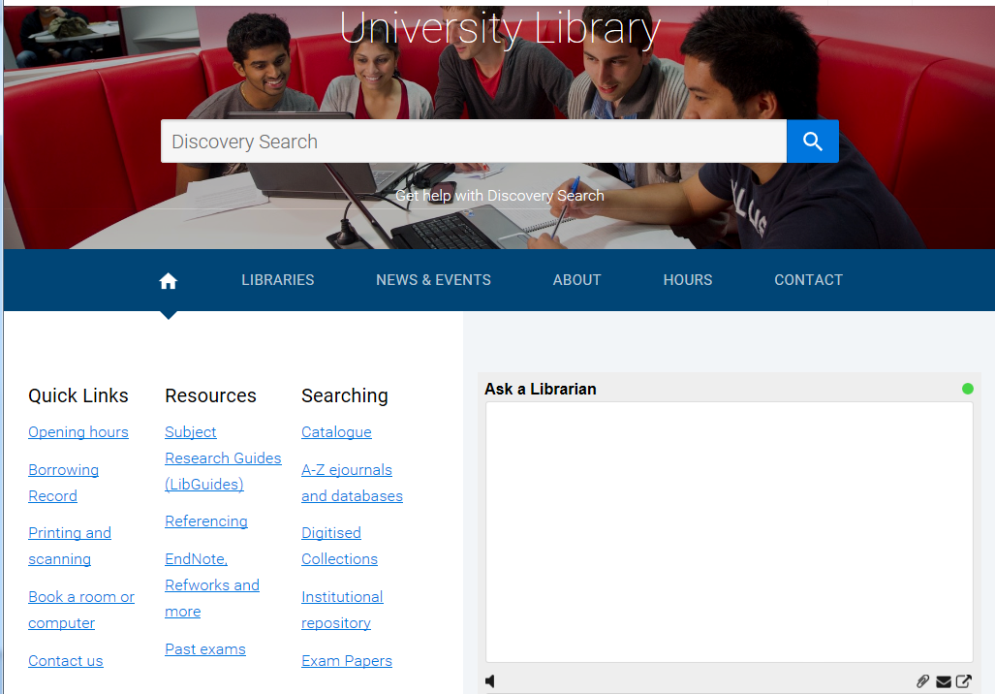
A ‘subject research guide’ showcases the library’s specialised resources for different areas of study.
You will find the guides on our website
library.unimelb.edu.au
Notes:
Update slide to include Advanced Search

Slide 14
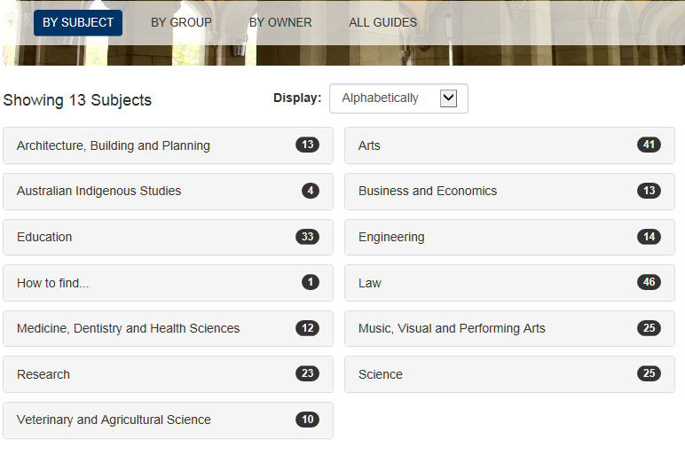
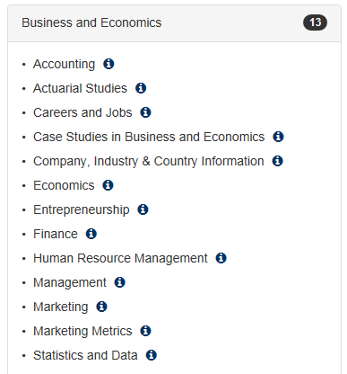
The range of business and economics guides will support you through your studies. Today we will focus on the ‘Company, Industry, & Country Information’ guide.

Slide 15
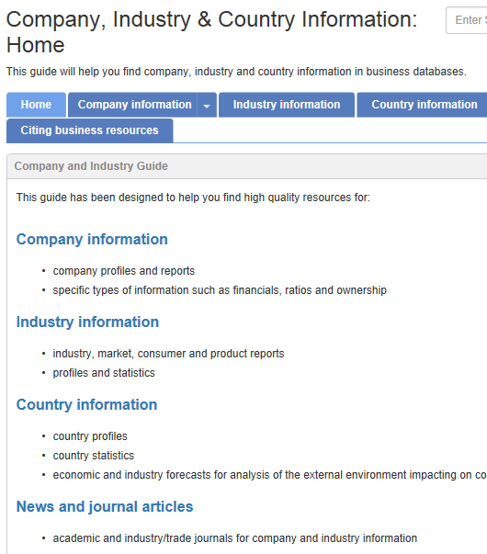
Levels of analysis
Macro-environment
Consumer market
Company
Product/ brand
Industry

Slide 16
1. Analyse The Walt Disney Company’s performance, including a SWOT (strengths, weaknesses, opportunities and threats) analysis.
What sources would contain this type of information?
What level of analysis do we need?
How can we find these sources?
1. Plan
3. Search
4. Evaluate results
5. Document
2. Identify sources

Slide 17
2. Analyse the Australian industry environment for theme parks, including historical and forecast industry revenues.
What sources would contain this type of information?
What level of analysis do we need?
How can we find these sources?
1. Plan
3. Search
4. Evaluate results
5. Document
2. Identify sources

Slide 18
Analysing & interpreting
You need to analyse and interpret data and information for your reader, not just describe it.
As the experts, you need to explain what the information means to other experts in your field as well as those outside it (non-experts).
Often, that means generalising the data rather than providing specific statistics, as well as highlighting implications.

Slide 19
Figure 1: Market share in the Australian ice cream industry
Little, S. (2016, April). IBISWorld Industry Report C1132: Ice Cream Manufacturing in Australia. [Major companies]. Retrieved from IBISWorld database.
Compare:
We can see from Figure 1 that market share in the Australian ice cream industry is broken down as follows: Regal Cream holds 8.9%, Unilever holds 29%, Peters Food Group has 34.8% with the remaining 27.3% held by other companies.
We can see from Figure 1 that the Australian ice-cream market is dominated by three organisations (Regal Cream Products, Unilever, and Peters Food Group) who collectively hold almost 75% of market share.
We can see from Figure 1 that the Australian ice-cream market is dominated by three organisations (Regal Cream Products, Unilever, and Peters Food Group) who collectively hold almost 75% of market share. High market share concentration can be a barrier to entry for smaller, less established brands who do not benefit from economies of scale in production and marketing.
description
analysis
analysis & interpretation
Notes:
We can see that three companies hold almost 75% of market share. But what does that mean? It means that they control, or dominate, the market. We now have the main point (our analysis) and the support for that idea.

Slide 20
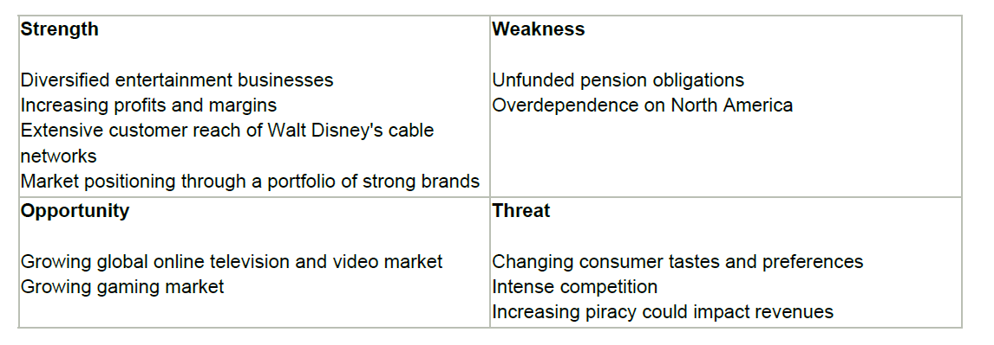
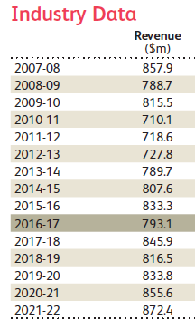
Your turn: analyse & interpret the data
Source: MarketLine Advantage, 2016, p. 23.
Source: Allday, 2016, p. 29.

Slide 21
STAGE 4: Planning [WHAT]
THINKING & ORGANISING
Defining & structuring your argument
Planning & structuring your paper
Notes:
Gathered info – now begin to formulate our own ideas/opinions based on the research.
Overall argument (WD should invest in Oz) + sub arguments (one strength is x, one weakness is x etc.)

Slide 22
Making an argument
Being emotional or negative
Presenting the conclusion you have reached based on your research
Topic | This paper will argue that…
Does privatisation stimulate economic growth? | …privatisation stimulates economic growth by increasing competition in the business sector.
The internet privacy war | ..internet privacy is an impossible goal because there are too many hackers and too much to gain
Are marketing and advertising the same thing? | …marketing and advertising are not the same thing because…

Slide 23
Argument structure
WD should invest in a theme park in Australia with X conditions because:
SWOT is positive
Aus. Market has long term potential
Leverage strong Aussie brand
Notes:
23
We have a thesis (with a plan of development/reasons) and we have organised our evidence .Now we need to work out how to fit it into the relevant format for the genre.

Slide 24
Argument mapping/planning
Consider the conclusions you made in the last activity: based on your analysis, what would you advise the Walt Disney Company?
Write down your argument / position in a topic sentence
Map out what support you will use.
Consider how you might sum up, or link to the next point.
Dot points only!

Slide 25
Body paragraphs
Analysis, not just a description.
Present & support your argument
Demonstrate analysis/reasoning
Interpret data and trends
Not too long
Must have a topic sentence
Only relevant information/detail
In logical order
One idea per paragraph

Slide 26
Support: how do we incorporate sources?
Direct Quotation – copy the words exactly, use quotation marks.
Paraphrase – copy the author’s idea, but express it in your own words (very different to original).
Use paraphrasing techniques
Summarise – take the main idea from a longer section of a text and express it in your own words.
All methods require citation (in text and reference list).
Notes:
Refer to sites. Highlight different styles – need to use a guide.
Cite everything you use!

Slide 27
Citing sources
You MUST cite all information from another source in the body of the text and in a reference list at the end.
In-text citation
Author prominent (APA):
Introduce the author’s work using name + (year) + reporting verb.
Alldey (2016) asserts that investing in this market is unlikely to generate large revenue streams in the short term.
OR
Information prominent (APA):
Put (name(s), year) at the end of the sentence
Investing in this market is unlikely to generate large revenue streams in the short term (Alldey, 2016).
Notes:
Refer to Ac Skills handout
Ss can build a list of reporting verbs while reading articles/texts [categorise according to the writer’s attitude].
Not just describing what someone says – beginning to show understanding and analysis.
Link to taking a position
Use example with Ag/D/N verbs to highlight.

Slide 28
Present & support your argument
Demonstrate analysis/reasoning
Interpret data and trends
The Walt Disney Company relies disproportionately on North American markets for revenue (MarketLine Advantage, 2016). Expanding into new markets has been recognised as an opportunity (MarketLine Advantage, 2016). The market fluctuated significantly from 2010 to 2017 (Alldey, 2016), and revenue is predicted to fall by 4.8% in the period 2016-17 (Alldey, 2016).
Unclear what the writer’s argument is.
Too descriptive – no analysis
Does not explain what the data means
Notes:
Don’t copy the referencing! Not correct APA!
Ss discuss what’s wrong with this.

Slide 29
Present & support your argument
Demonstrate analysis/reasoning
Interpret data and trends
Writer’s argument
Analysis + interpretation
Investing in the Australian theme park market will allow the Walt Disney Company to reduce risk by diversifying its operations and generating more balanced revenue streams. Currently, the company relies disproportionately on North American markets for revenue (MarketLine Advantage, 2016), leaving it exposed to risks associated with political and economic fluctuations. Expanding into different global markets, such as Australia, presents an opportunity to mitigate these country-specific risks by broadening revenue streams. While investing in this market is unlikely to generate large revenue streams in the short term, as it fluctuated significantly from 2010 to 2017 (Alldey, 2016), and revenue is predicted to fall by 4.8% in the period 2016-17 (Alldey, 2016), it is a viable long-term strategy. Given the strong financial position of the company, this provides an opportunity for Walt Disney to leverage its strong brand name and develop a new product offering for the Australian market.
Interpret data
Sum up
Notes:
Better version.

Slide 30
STAGE 5: Writing
Use your plan to write
Ensures a logical flow and clear argument
Follow your structure
Draft and re-draft your work
Use appropriate language/style for the task

Slide 31
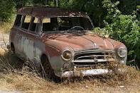
Style: precision
Use simple but precise words
Use specific language – general terms can be open to different interpretations = don’t be vague.
I want you to imagine an old car.
Notes:
Did you imagine a classic shiny white 1933 Mercedes Benz or a brown rusty 1977 Holden?

Slide 32
The writing - words
Use clear, concise words and phrases.
Instead of | write
communicate
demonstrate
initiate
terminate
transmit
utilise
write, talk, tell
show
begin
end
send
use
Notes:
p60

Slide 33
The writing - words
Avoid business jargon.
Instead of | write
consideration was given
on a daily basis
without further delay
we are not in the position to
prior to the
in reference to
I considered
daily
now
We cannot
before
about
Notes:
P 61

Slide 34
The writing - words
Avoid redundancies.
absolutely complete
basic fundamentals
thought and consideration
summarise briefly
personal opinion
green in colour
Notes:
P 60

Slide 35
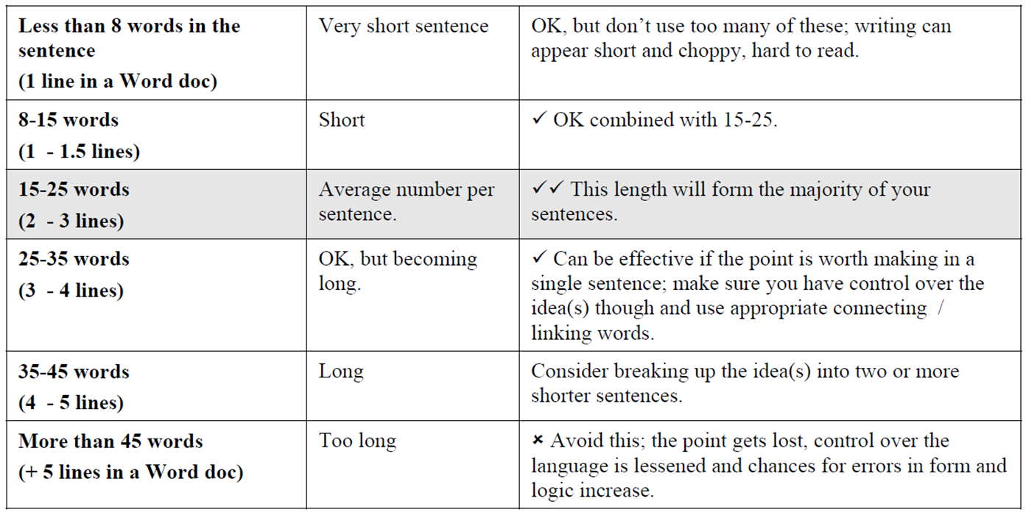
The writing - sentences
How long should a sentence be?
Notes:
Variety is key. Avoid too long or too short.

Slide 36
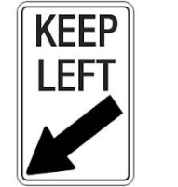
Actors and Actions
In other words:
Who/what | does | what?
My dog | ate | my assignment.
My assignment was eaten by my dog
end weight
Who did what?

Slide 37
Passive → Active
Use active voice (where possible). It’s punchier.
Passive
It is expected that weaker industry profit will be seen over the next few years as a result of these factors.
Active
“These factors are also expected to result in weaker industry profit over the next five years.” (p.5)
Allday, A. (2015, June). IBISWorld Industry Report R9131. Amusement Parks and Centres Operation in Australia. Retrieved from: http://www.ibisworld.com.au
Notes:
Try changing to active

Slide 38
Checklist
Content:
Accessible for reader
Analyses sources
Interprets data [not just description]
Structure:
Appropriate for genre
Paragraph contains one main idea
Inverted pyramid structure
Style:
Simple
Precise
No redundancy
Variety of sentence lengths
Active voice

Slide 39
STAGE 5: writing/drafting activity
You have 15 minutes to draft your paragraph.
Clear argument that’s well supported [should WD invest or not and why?]
Well integrated sources (not just description)
Appropriate structure & style

Slide 40
Source: MarketLine Advantage, 2016, p. 23.
Source: Allday, 2016, p. 29.

Slide 41
STAGE 6: Editing & Proofreading
Read from a reader’s perspective
Check each paragraph is relevant
Check for a logical flow
Check use of specialist terms
Look at the task again: have you completed everything you were asked?
Proofread for grammar/spelling etc.

Slide 42
Good Writing
Is the result of a process
Uses appropriate language and tone
Addresses the task accurately and adequately
Draws extensively and skilfully on sources
Takes a position: doesn’t just describe
Analyses findings or observations & interprets data
Is clearly structured
Is well presented – grammar, sentence structure, spelling, bibliography.

Slide 43
How can Academic Skills help?
Online resources
Workshops & courses
Individual tutorials
Reading strategies
Presentation skills
Time management
Writing skills
Critical thinking
Listening & note-taking
Exam preparation
English Language
http://services.unimelb.edu.au/academicskills

Slide 44
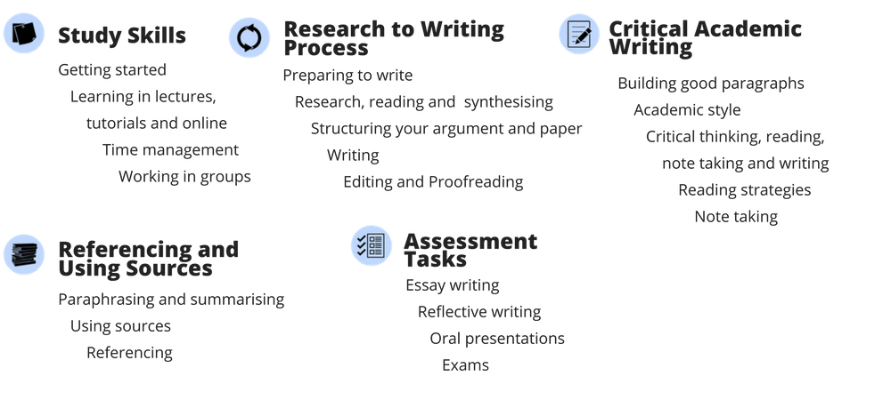
Online resources
Access from the Academic Skills website, or look under the “My Communities” tab on the right in your LMS homepage

Slide 45
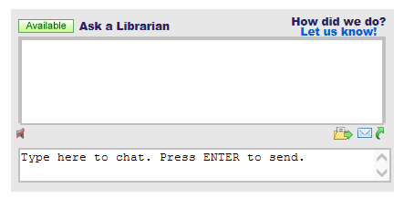
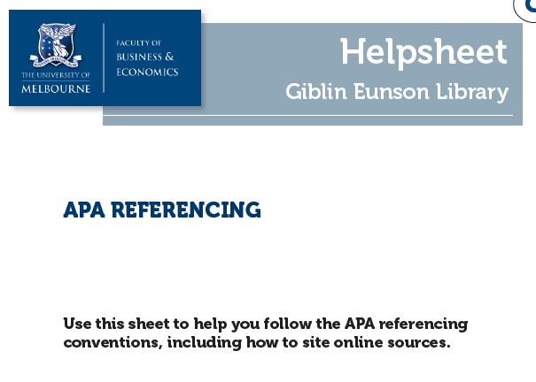
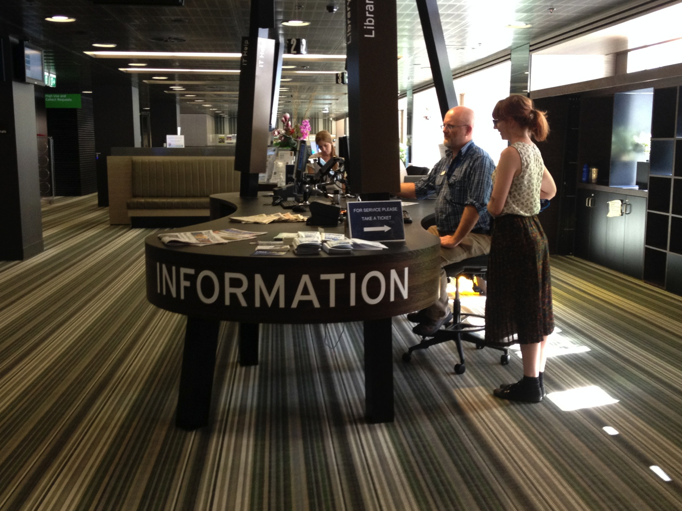
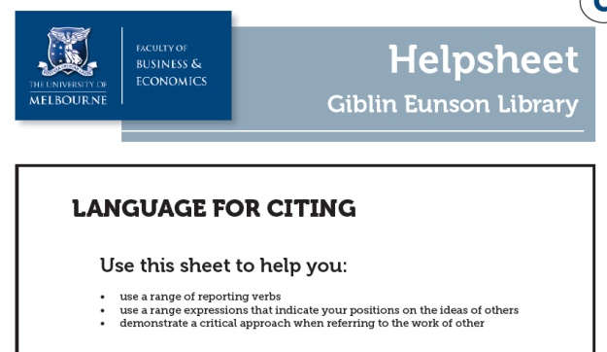
Need more help from the library?
Online helpsheets
library.unimelb.edu.au/business-resources
Visit the Giblin Eunson Library information desk
Chat online with us @ library.unimelb.edu.au

Slide 46
Further support from the library
As graduate students, you can book individual or group research consultations with us to help you find information and develop your research skills.
Book online through the library homepage.
http://library.unimelb.edu.au/research/research-consultations

Slide 47
References
Allday, A. (2016, November). IBISWorld Industry Report R9131. Amusement Parks and Centres Operation in Australia. Retrieved from: http://www.ibisworld.com.au
MarketLine Advantage. (2016, July 22). The Walt Disney Company. Retrieved from MarketLine Advantage database.
Unilearning. (2000). The essay writing process [diagram]. Retrieved from http://unilearning.uow.edu.au/essay/1b.html
University of Canberra. (n.d.). Writing a report [table]. Retrieved from http://learnonline.canberra.edu.au/mod/book/view.php?id=180631&chapterid=332

